Slide 1

3
Developing Project Proposals

Slide 2
Chapter Concepts
Building relationships with customers and partners
Proposal marketing strategies
Decision making to develop a proposal
Creating winning proposals
The proposal preparation process
Elements that may be included in a proposal
Pricing considerations
Customer evaluation of proposals
Types of contracts between the customer and the contractor
Measuring the success of proposal efforts

Slide 3
Learning Outcomes
Develop relationships with customers and partners
Decide whether to prepare a proposal in response to a customer’s RFP
Create a credible proposal
Determine a fair and reasonable price for a proposal
Discuss how customers evaluate proposals
Explain types of contracts and various terms and conditions
Measure the success of proposal efforts

Slide 4
Project Procurement Management
Project Management Knowledge Areas from PMBOK® Guide

Slide 5
Building Relationships with Customers and Partners
Foundation for successful funding and opportunities
Requires good listening and constant learning
Frequent and regular contact; express appreciation for the client’s time
Trust is key and ethics are imperative
First impression is important
Problem solving and credibility grows with good performance
Partner with several key individuals in an organization

Slide 6
Pre-RFP/Proposal Marketing
Begin developing the relationship before RFP is prepared
  Can help client identify needs
  Better position to win the contract
  Develop a more clearly focused response to RFP
Pre-RFP and pre-proposal efforts are business development
  No cost to the customer
  Help build the relationship
Unsolicited proposals and uncompetitive contracts
  Result of identified needs and problem solving
  Eliminates preparation of an RFP and soliciting process

Slide 7
Decision to Develop a Proposal
Development is costly and time consuming
Contractors must be realistic about their probability of winning a contract
Evaluate bid/no-bid decision
Many non-winning proposals hurt reputation
May be hard to decide to no-bid an RFP

Slide 8
Bid or No-Bid?
Factors to consider
  Competition
  Risk
  Mission
  Extension of capabilities
  Reputation
  Customer funds
  Proposal resources
  Project resources

Slide 9
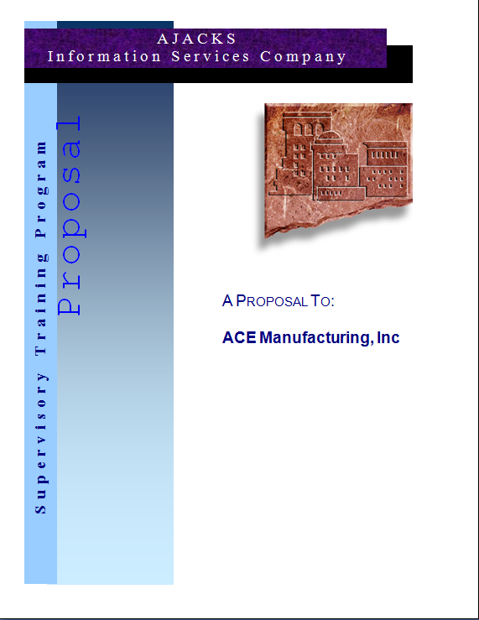
Creating a Winning Proposal
Selling document
The best idea to solve the problem
Highlight unique factors
Emphasize benefits to the customer
Be simple and concise
Addresses requirements from RFP
Be realistic

Slide 10
Proposal Preparation
Proposal team
  Can be one person or many
  Various skills and expertise
  Proposal manager for large proposals
Proposal development
  Time for writing, review, and management approval
  Length dependent upon the RFP requirements
  Cost of proposal development is part of normal business costs

Slide 11
Proposal Contents
Three sections
  Technical
  Management
  Cost
Detail level
  Depends on complexity of the project
  Requirements from the RFP

Slide 12

Technical Section
Understand the need
Proposed approach or solution
Benefits to the customer

Slide 13

Management Section
Description of major tasks
Deliverables
Project schedule
Project organization
Related experience
Equipment and facilities

Slide 14
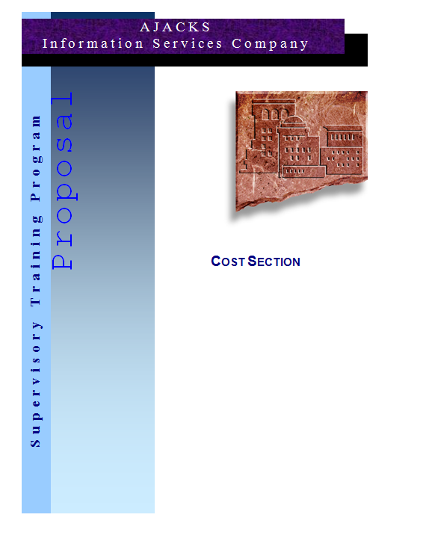
Cost Section
Include estimated costs
  Labor
  Materials
  Equipment
  Facilities
  Subcontractors and consultants
  Travel
  Documentation
  Overhead
  Escalation
  Reserve
  Fee or profit

Slide 15
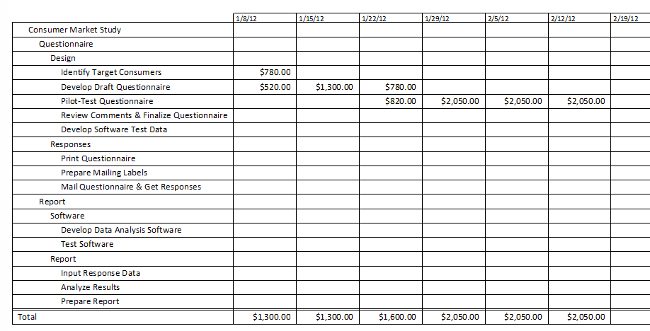
Pricing Considerations
Competition
Price
  Not overpriced or underpriced
Factors
  Reliability of cost estimates
  Risk
  Value of project to the contractor
  Customer’s budget
  Competition level

Slide 16
Simplified Project Proposal
Complex
Simplified
Large number of pages
Defined sections
Charts and figures
Tables of information
Statement of the customer’s need
Assumptions
Project scope
Deliverables
Resources
Schedule
Price
Risks
Expected benefits

Slide 17
Proposal Submission and Follow-up
Submission
Follow-up
On time
Formatted properly
Sent in manner required
  Hard copies
  E-mail
  Electronic form
Two sets by different delivery methods
Be proactive
Professional manner
Follow RFP guidelines

Slide 18
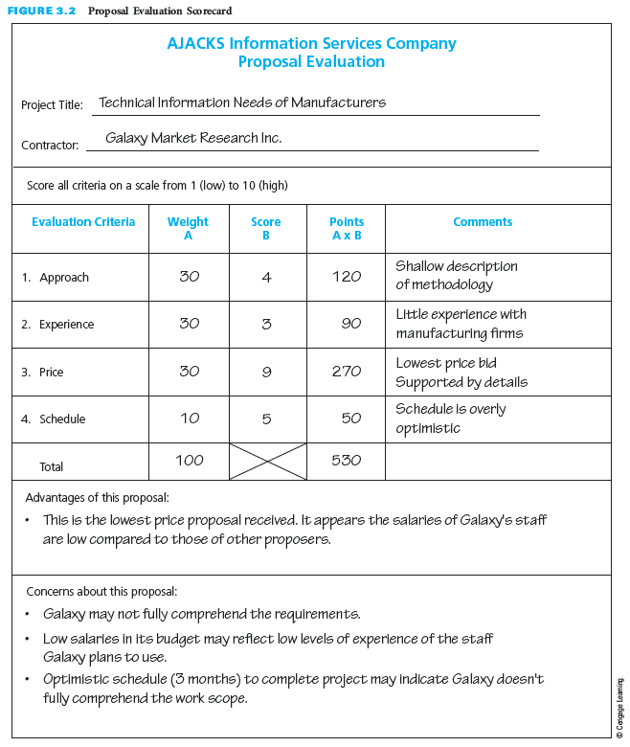
Customer Evaluation of Proposals
Customer sets criteria
Customer may request a best and final offer (BAFO)
Helps to have common comparison criteria

Slide 19
Contracts
Agreement
Types
Contract must be signed before starting work
Establishes communication
Agreement of deliverables for a certain price
Fixed Price
  Price remains fixed
  Low risk for customer
  High risk for contractor
  For well-defined projects with little risk
Cost-Reimbursement
  Price for actual costs
  High risk for customer
  Low risk for contractor
  For higher risk projects

Slide 20
Contract Terms and Conditions
Misrepresentation of costs
Notice of cost overruns or schedule delays
Approval of subcontractor
Customer furnished equipment of information
Patents
Disclosure of proprietary information
International considerations
Termination
Terms of payments
Bonus/penalty payments
Changes

Slide 21
Measuring Proposal Success
Measures
Strategies
Win ratio
  Number won/number submitted
  All proposals weighted equally
Total dollar value
  Value won/value submitted
  More weight to larger values
Submit many to win fair share
  Increase chances of winning
  May be viewed negatively
Bid on potential successes
  Respond where better than average chance to win
  Must have bid/no-bid process

Slide 22
Critical Success Factors
Customers and partner organizations prefer to work with people they know and trust. Relationships establish the foundation for successful funding and contract opportunities.
Establishing and building trust is key to developing effective and successful relationships with clients and partners.
The first impression one makes on a client is pivotal to developing a continuing and fruitful relationship.
Pre-RFP/proposal efforts are crucial to establishing the foundation for eventually winning a contract from the customer.
Do not wait until formal RFP solicitations are announced by customers before starting to develop proposals. Rather, develop relationships with potential customers long before they prepare their RFPs.
Working closely with a potential customer puts a contractor in a better position to be selected as the winning contractor. Learn as much as possible about the customer’s needs, problems, and decision-making process during pre-RFP/proposal marketing.

Slide 23
Critical Success Factors (continued)
Becoming familiar with the customer’s needs, requirements, and expectations will help in preparing a more clearly focused proposal.
Be realistic about the ability to prepare a quality proposal and about the probability of winning the contract. It is not enough just to prepare a proposal; rather, the proposal must be of sufficient quality to have a chance of winning.
A proposal is a selling document, not a technical report. It should be written in a simple, concise manner and should use terminology with which the customer is familiar.
In a proposal, it is important to highlight the unique factors that differentiate it from competitors’ proposals.
Proposals must be realistic. Proposals that promise too much or are overly optimistic may be unbelievable to customers, and may raise doubt about whether the contractor understands what needs to be done or how to do it.
When bidding on a fixed-price project, the contractor must develop accurate and complete cost estimates and include sufficient reserve.

Slide 24
Summary
Interested contractors develop proposals in response to a customer’s RFP.
Relationships establish the foundation for successful funding and contract opportunities. Relationship building requires being proactive and engaged.
Contractors should develop relationships with potential customers long before customers prepare an RFP.
Because the development and preparation of a proposal take time and money, contractors interested in submitting a proposal in response to an RFP must be realistic about the probability of being selected as the winning contractor.
It is important to remember that the proposal process is competitive and that the proposal is a selling document that should be written in a simple, concise manner. In the proposal, the contractor must highlight the unique factors that differentiate it from competing contractors.
Proposals are often organized into three sections: technical, management, and cost.
Customers evaluate contractors’ proposals in many different ways.
Once the customer has selected the winning contractor, the contractor is informed that it is the winner, subject to successful negotiation of a contract: fixed-price and cost reimbursement are the two types of contracts.
Contractors measure the success of their proposal efforts by the number of times their proposals are selected by customers and/or by the total dollar value of their proposals that are selected.

